Slide 1
Building Ling’s Adder Using Virtuoso

Slide 2
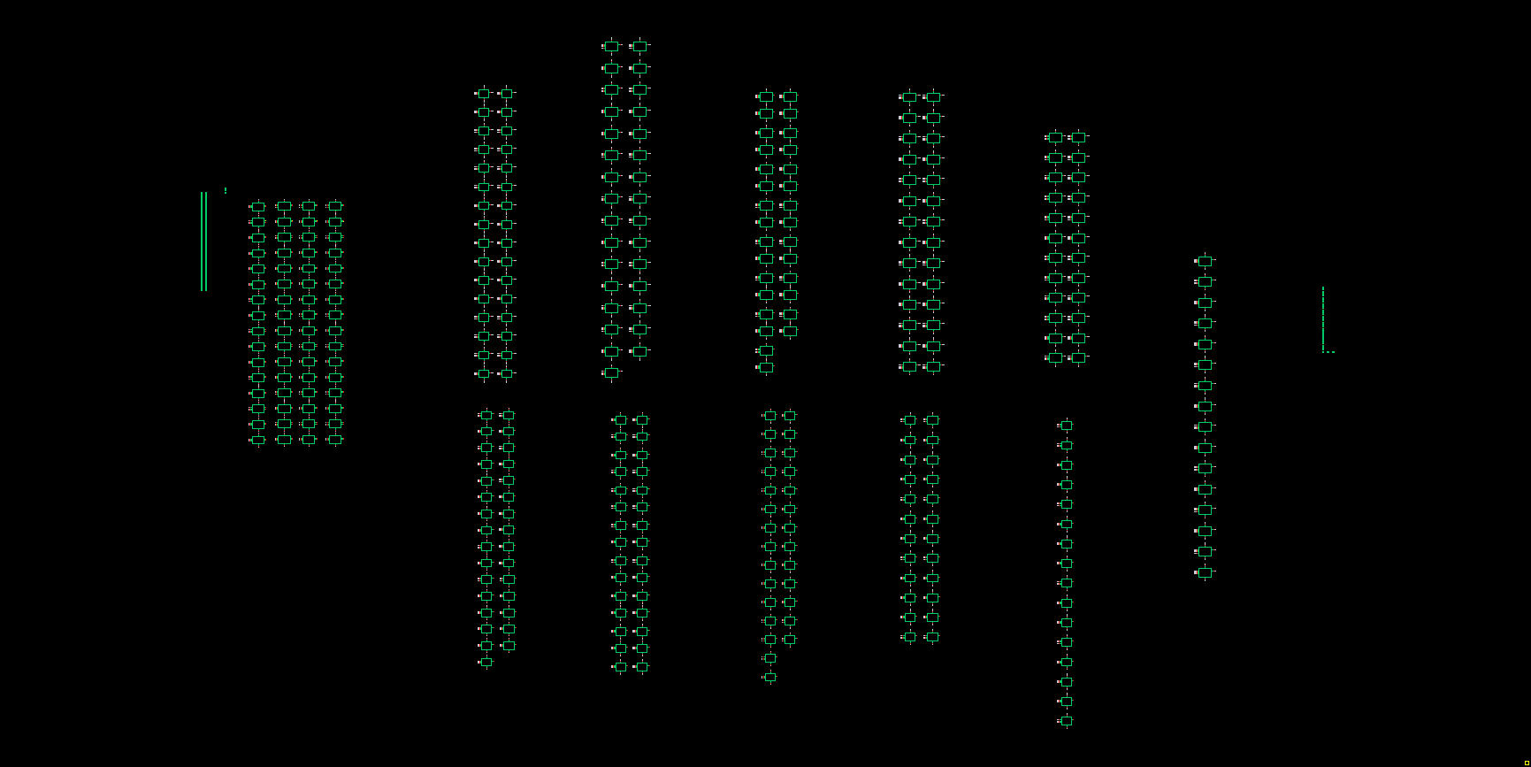
Architecture
64-bit domino logic

Slide 3
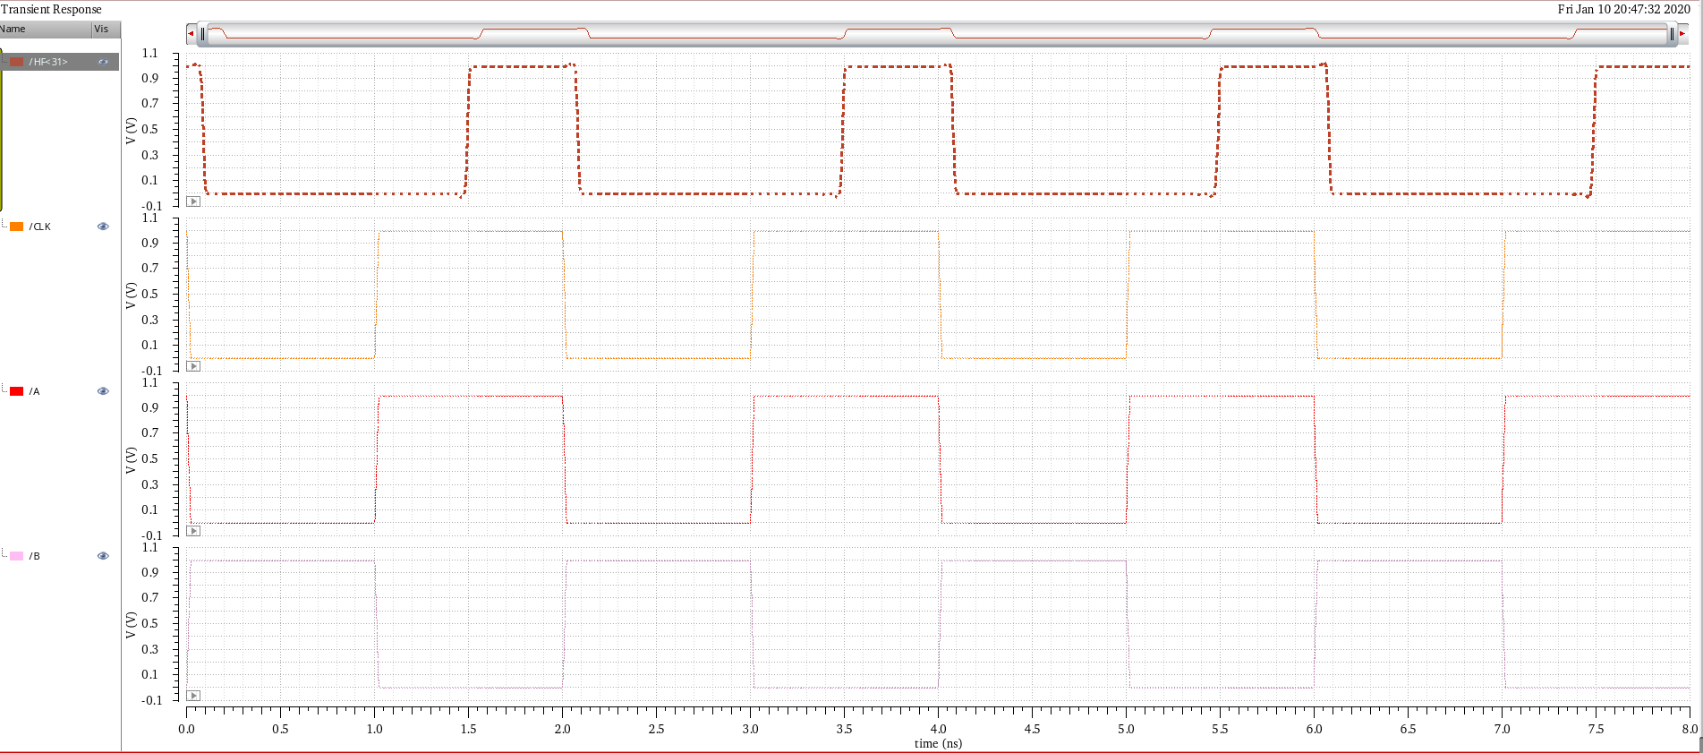
Transient simulation
Input: a 0000…0001, b 1111…1111
Clock period: 2n s

Slide 4
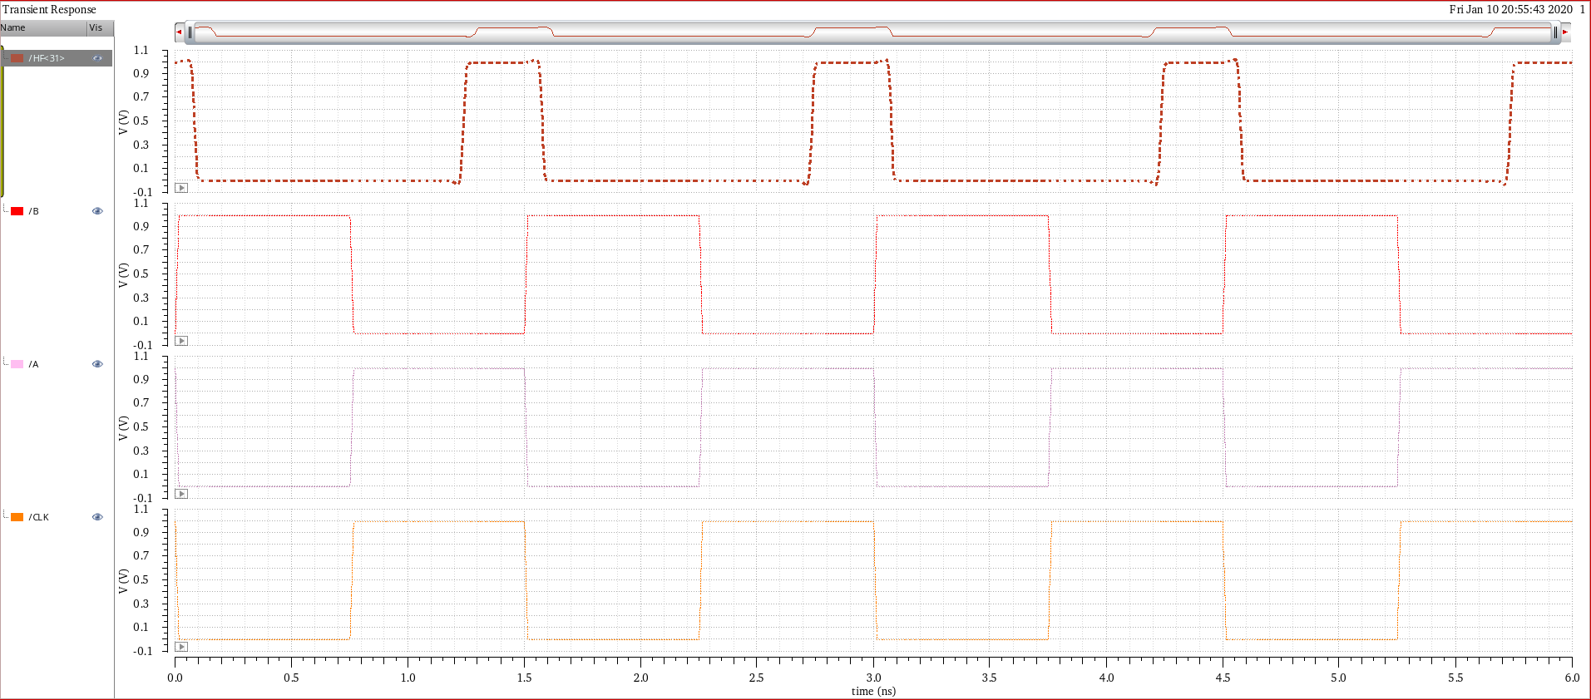
Transient simulation
Input: a 0000…0001, b 1111…1111
Clock period: 1.5n s

Slide 5
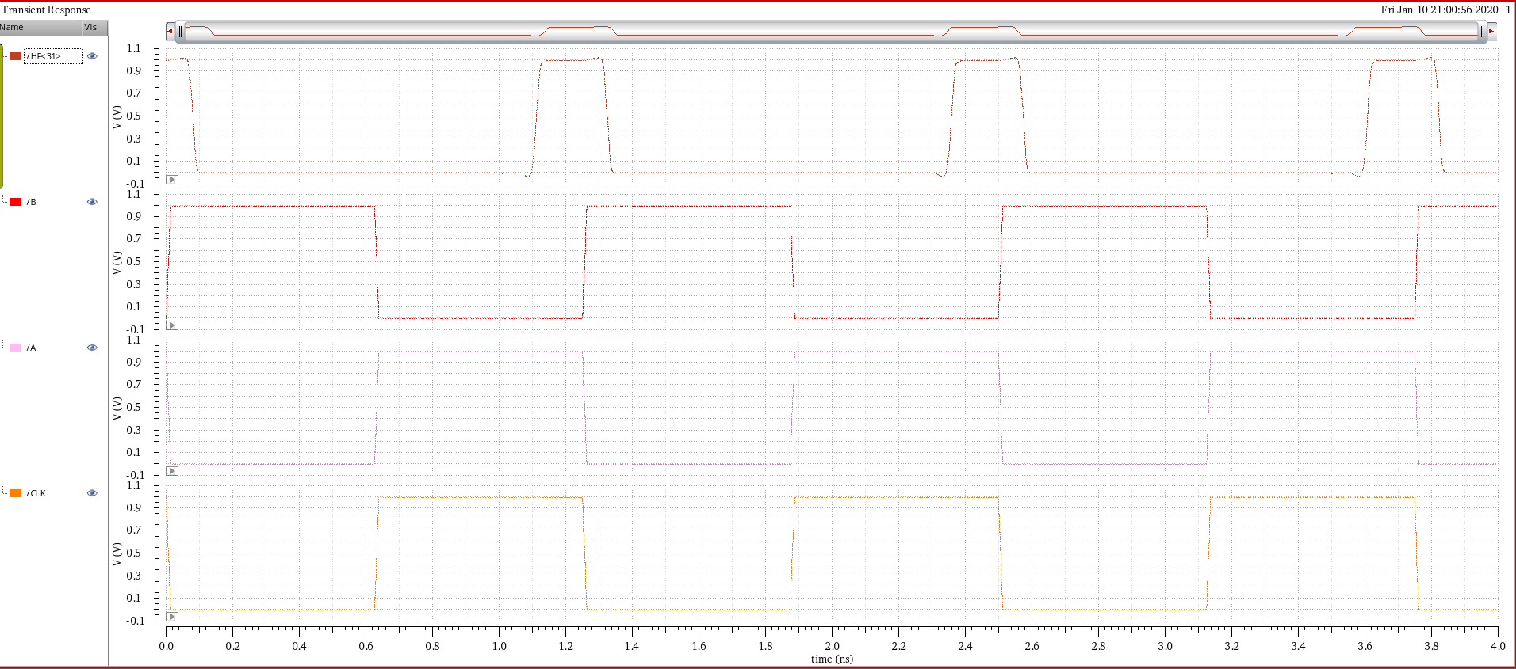
Transient simulation
Input: a 0000…0001, b 1111…1111
Clock period: 1.25n s

Slide 6
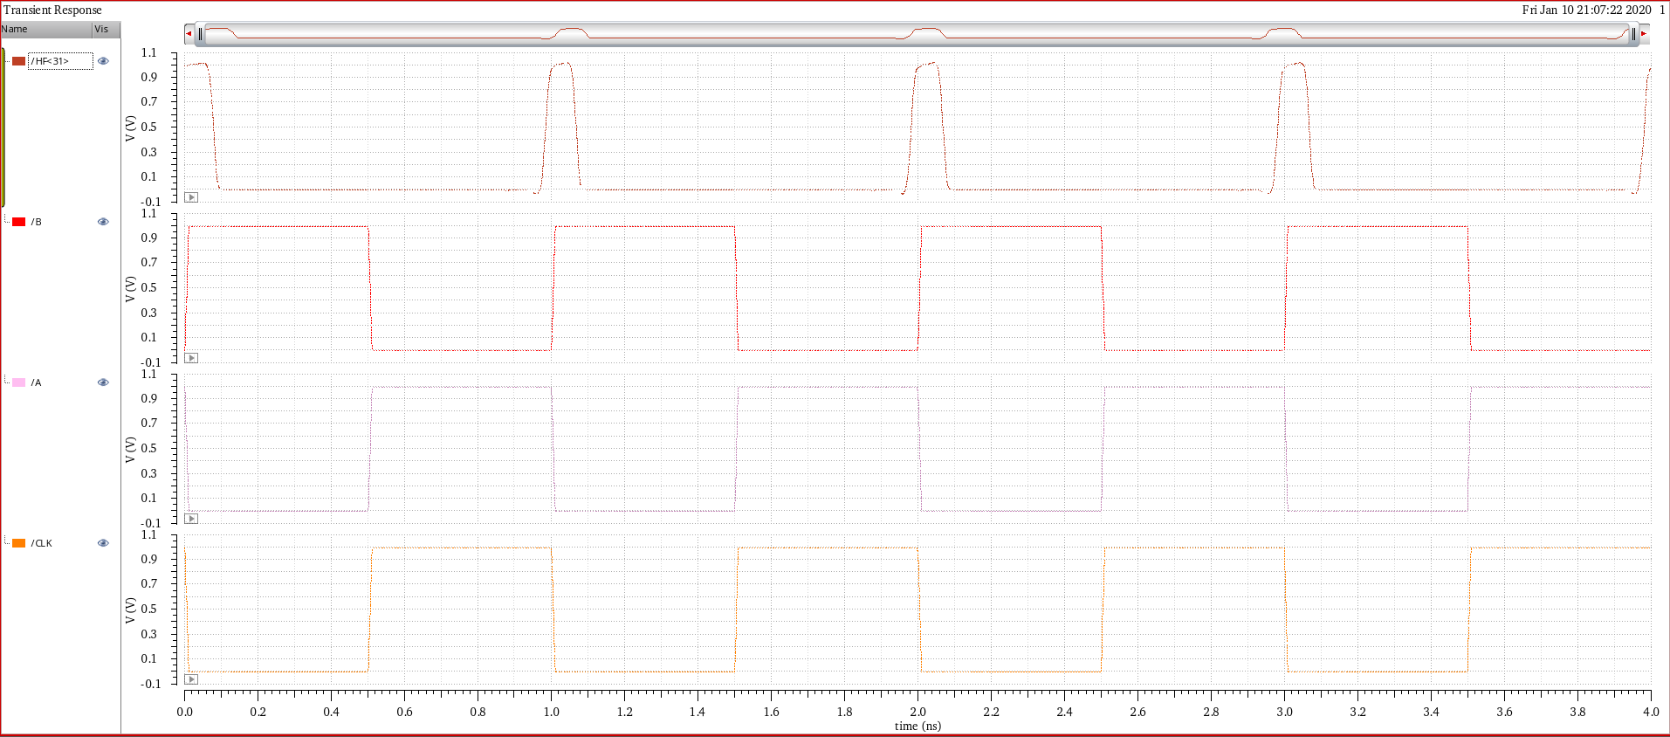
Transient simulation
Input: a 0000…0001, b 1111…1111
Clock period: 1n s

Slide 7
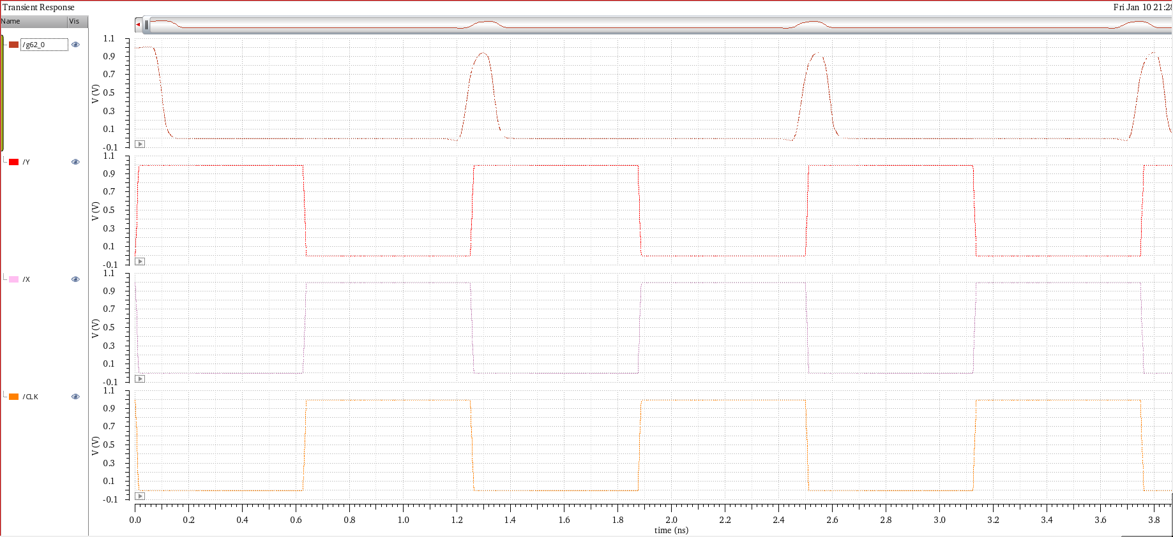
Transient simulation
Input: a 0000…0001, b 1111…1111
Clock period: 1.25n s
Conventional equation

